Slide 1
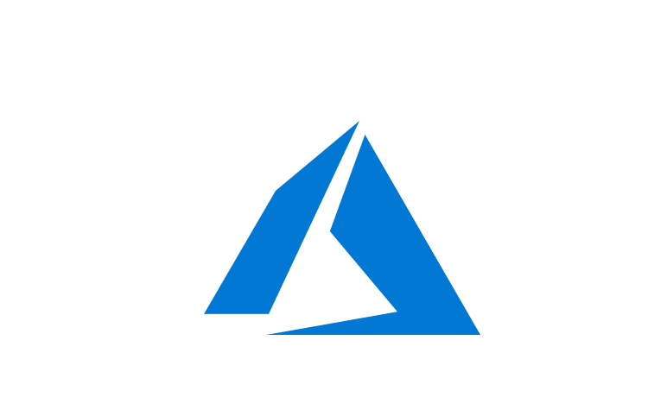
Module 12: Azure Migrate Server Migration
Solutions for Migration using Azure Migrate

Slide 2
Module 12: Azure Migrate Server Migration
Lesson 1: Migrate Workloads using Azure Migrate
Lesson 2: VMware Agentless Migration
Lesson 3: VMware Agent-Based Migration
Lesson 4: Implement Azure Backup
Lesson 5: Azure to Azure Site Recovery
Lesson 6: Lab
Lesson 7: Module 9 Review Questions

Slide 3

Lesson 1: Overview of Azure Migrate Server Migration

Slide 4
Lesson Overview
Overview of Azure Migrate Server Migration
VMware Migration
Deployment Steps Comparison
Hyper-V Migration
Agent-based Migration Architecture
Azure Migrate and ASR – What’s New?

Slide 5
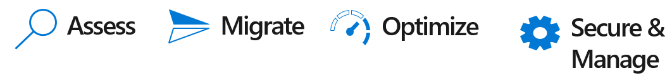
Overview of Azure Migrate Server Migration
Helps you to migrate on-premises VMware VMs, Hyper-V VMs, physical servers, other virtualized machines, and private/public cloud instances to Azure

Slide 6
VMware Migration
VMware VMs can be migrated using Azure Migrate Server Migration with the following two options:
Agentless replication: Migrate VMs without needing to install anything on them.
Agent based replication: Install an agent on the VM for replication.
Agentless replication is easier to deploy in VMware, but currently has some limitations
Simultaneous replication – maximum of 300 VMs migrated at a time
VM must have 60 or less disks
VM operating systems may need manual changes before migration
Issues with Linux/EUFI boot, encrypted disks/volumes, NFS volumes, and target storage

Slide 7
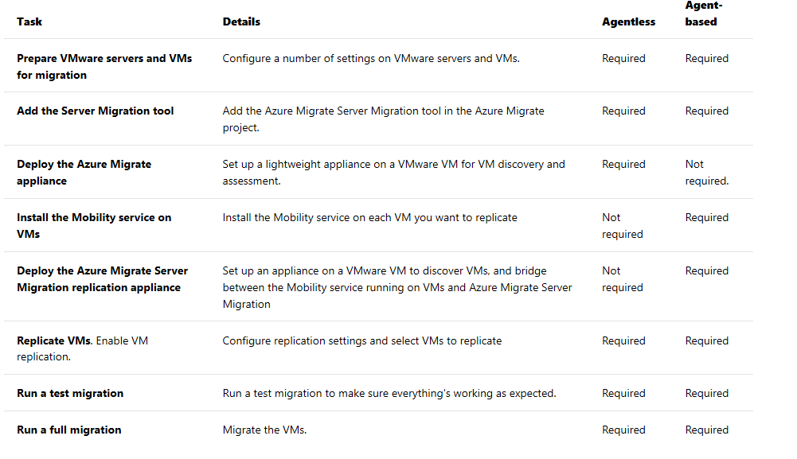
Deployment Steps Comparison

Slide 8
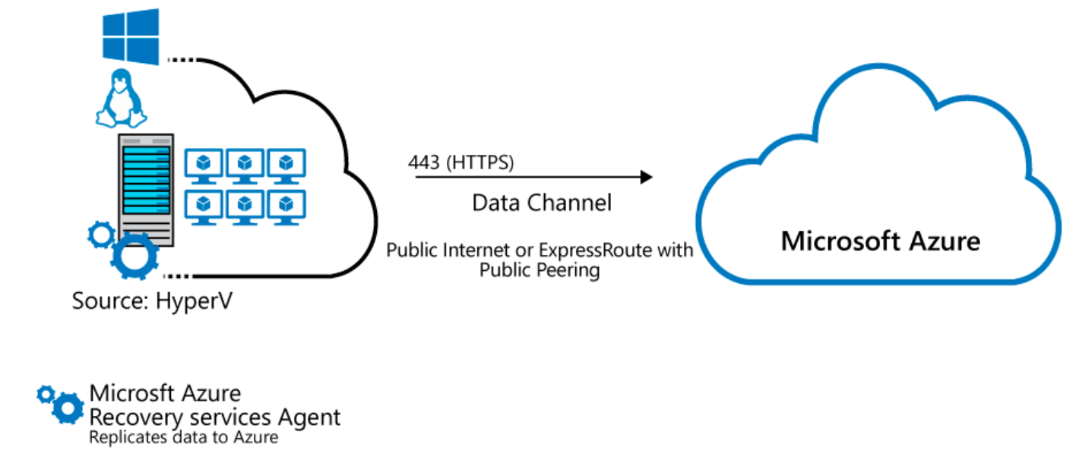
Hyper-V Migration
Agentless
Host Based

Slide 9
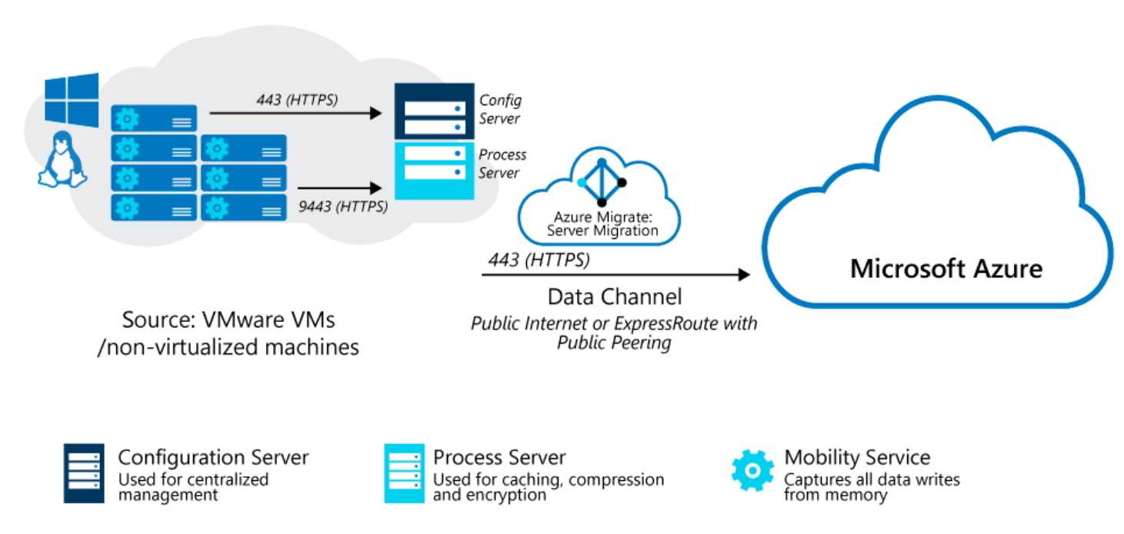
Agent-Based Migration Architecture
Configuration VM
ESXi hosts >v5.5
Permissions
VM Requirements
Mobility Service
Azure Storage

Slide 10
Instructor Notes
Slides 13 – 64 can be demonstrated directly from the Azure Portal
Next:

Slide 11
Lesson 2: VMware Agentless Migration

Slide 12
Prepare for Agentless VMware Migration
Review VMware server requirements for agentless migration.
Set up an account to access the vCenter Server with the required permissions for agentless migration.
Note the requirements for VMware VMs that you want to migrate to Azure using agentless migration.
Review appliance requirements for agentless migration.
Note appliance URL access and port access requirements for agentless migration.

Slide 13
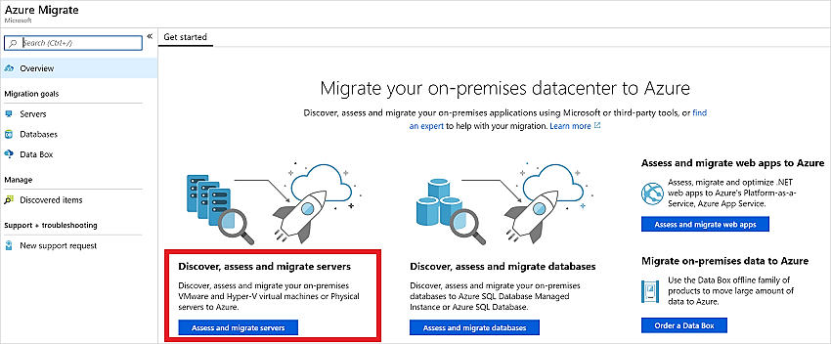
Add the Azure Migrate Server Migration Tool (1 of 3)
In the Azure Migrate project, click Overview.
In Discover, assess, and migration servers, click Assess and migrate servers.

Slide 14
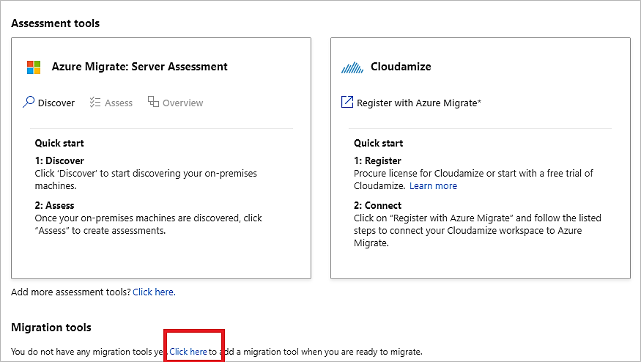
Add the Azure Migrate Server Migration Tool (2 of 3)
In Migration tools, select Click here to add a migration tool when you are ready to migrate

Slide 15
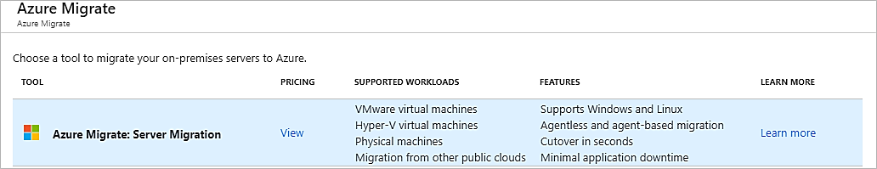
Add the Azure Migrate Server Migration Tool (3 of 3)
In the tools list, select Azure Migrate: Server Migration > Add tool

Slide 16
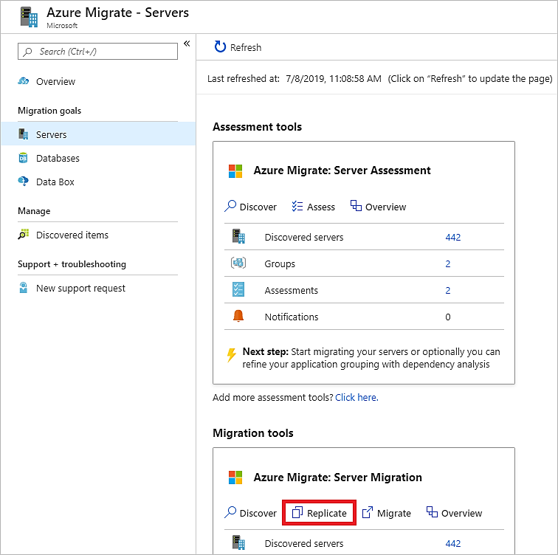
Replicate VMs
In the Azure Migrate project > Servers, Azure Migrate: Server Migration, click Replicate

Slide 17
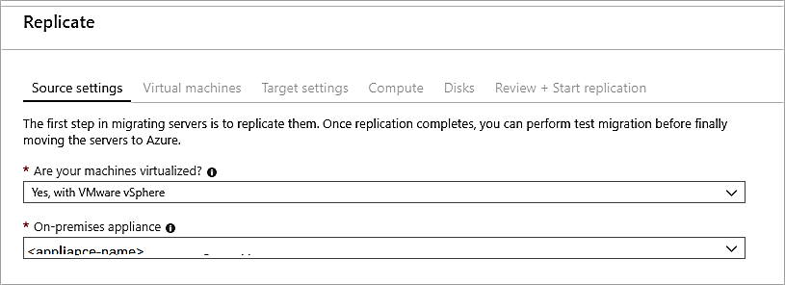
In Replicate, > Source settings > Are your machines virtualized?, select Yes, with VMware vSphere.
In On-premises appliance, select the name of the Azure Migrate appliance that you set up > OK.

Slide 18
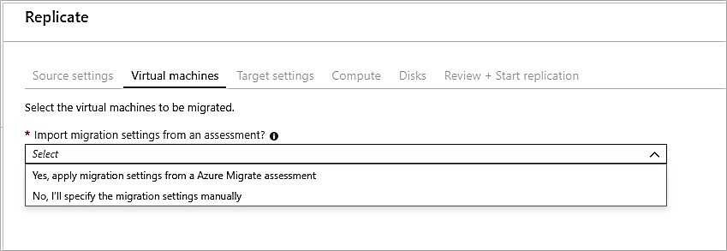
In Virtual machines, select the machines you want to replicate.

Slide 19
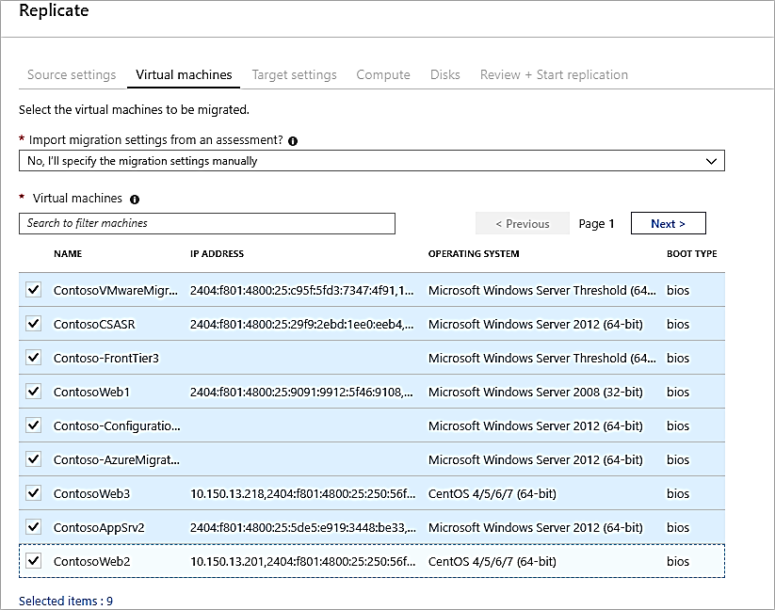
In Virtual machines, search for VMs as needed, and check each VM you want to migrate. Then click Next: Target settings.

Slide 20
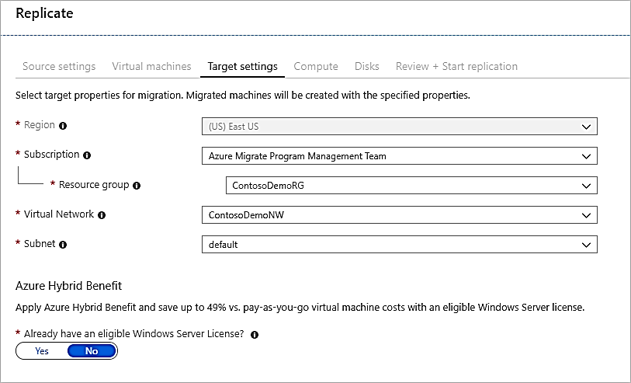
Target Settings

Slide 21
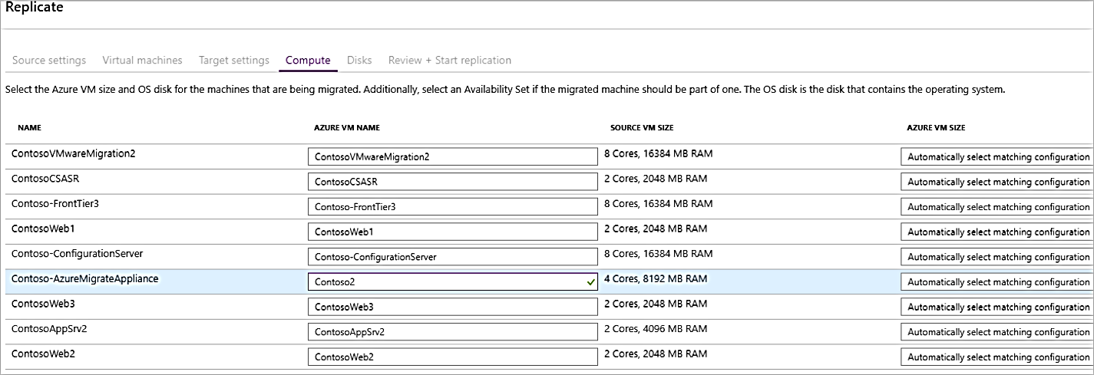
Compute Settings

Slide 22
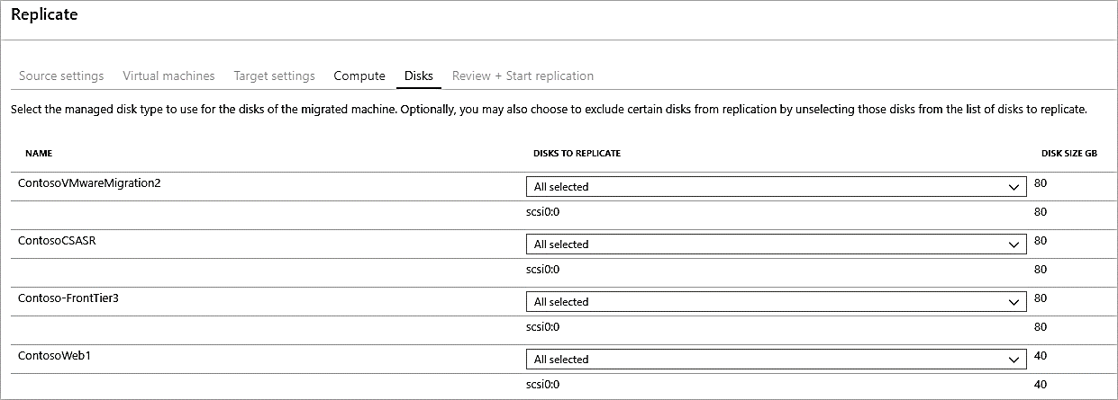
Disk Settings

Slide 23
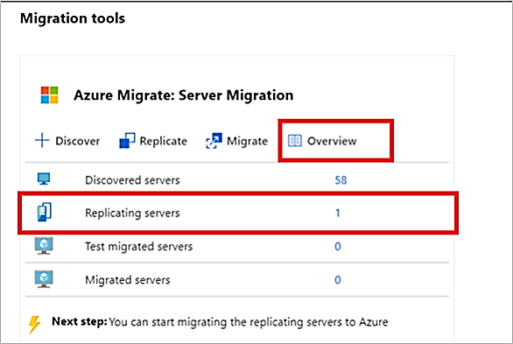
Tracking and Monitoring Replication
You can monitor replication status by clicking on Replicating servers in Azure Migrate: Server Migration

Slide 24
Provisioning For the First Time
If this is the first VM you're replicating in the Azure Migrate project, Azure Migrate Server Migration automatically provisions these resources in same resource group as the project.
Service bus
Gateway storage account
Log storage account
Key vault

Slide 25
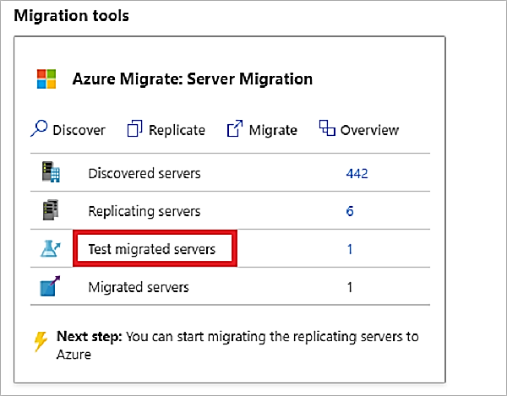
Test Migration
In Migration goals > Servers > Azure Migrate: Server Migration, click Test migrated servers.

Slide 26
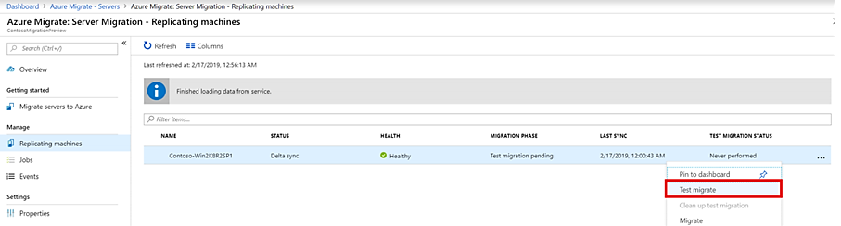
Right-click the VM to test, and click Test migrate

Slide 27
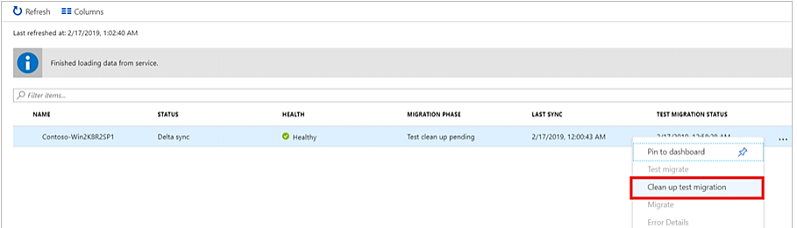
After the test is done, right-click the Azure VM in Replicating machines, and click Clean up test migration

Slide 28
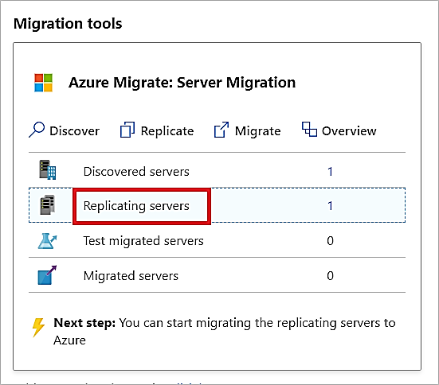
Migrate Virtual Machines
After you've verified that the test migration works as expected, you can migrate the on-premises machines.
In the Azure Migrate project > Servers > Azure Migrate: Server Migration, click Replicating servers
In Replicating machines, right-click the VM >Migrate

Slide 29
Lesson 3: VMware Agent-Based Migration

Slide 30
Prepare Azure
Before you can migrate with Azure Migrate Server Migration you need to:
Create a project
Register the Azure Migrate replication appliance
Create Key Vault

Slide 31
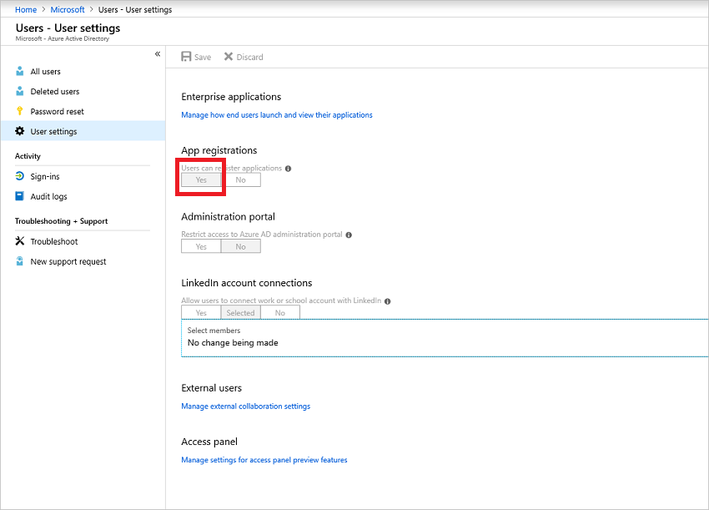
Prepare Azure – Grant Account Permissions
Prepare Azure

Slide 32
Prepare VMware
Task | Role/Permissions | Details
VM discovery | At least a read-only user Data Center object –> Propagate to Child Object, role=Read-only | User assigned at datacenter level and has access to all the objects in the datacenter. To restrict access, assign the No access role with the Propagate to child object, to the child objects (vSphere hosts, datastores, VMs and networks).

Slide 33
Full replication, failover, failback | Create a role (Azure_Site_Recovery) with the required permissions, and then assign the role to a VMware user or group Data Center object –> Propagate to Child Object, role=Azure_Site_Recovery Datastore -> Allocate space, browse datastore, low-level file operations, remove file, update virtual machine files Network -> Network assign Resource -> Assign VM to resource pool, migrate powered off VM, migrate powered on VM Tasks -> Create task, update task Virtual machine -> Configuration Virtual machine -> Interact -> answer question, device connection, configure CD media, configure floppy media, power off, power on, VMware tools install Virtual machine -> Inventory -> Create, register, unregister Virtual machine -> Provisioning -> Allow virtual machine download, allow virtual machine files upload Virtual machine -> Snapshots -> Remove snapshots | User assigned at datacenter level and has access to all the objects in the datacenter. To restrict access, assign the No access role with the Propagate to child object, to the child objects (vSphere hosts, datastores, VMs and networks).

Slide 34
Mobility Service Installation
Mobility service must be installed on machines you want to replicate
Prepare the account as follows:
A domain or local account with permissions to install on the VM.
For Windows VMs, if you're not using a domain account:
Disable Remote User Access control on the local machine by adding the DWORD entry LocalAccountTokenFilterPolicy, with a value of 1 in the registry, under HKEY_LOCAL_MACHINE\SOFTWARE\Microsoft\Windows\CurrentVersion\Policies\System
For Linux VMs, prepare a root account on the source Linux server.

Slide 35
Add the Azure Migrate Server Migration Tool
In the Azure Migrate project, click Overview.
In Discover, assess, and migration servers, click Assess and migrate servers.

Slide 36
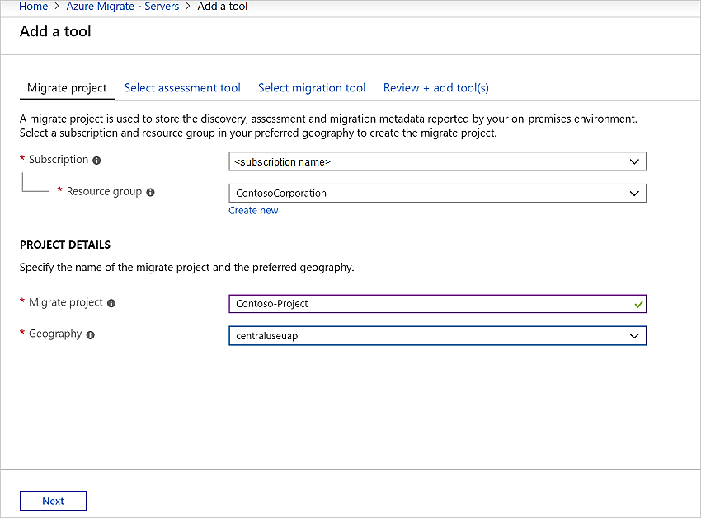
In Discover, assess and migrate servers, click Add tools

Slide 37
Replication Appliance
The replication appliance is a single, highly available, on-premises VMware VM that hosts these components:
Configuration server: The configuration server coordinates communications between on-premises and Azure and manages data replication.
Process server: The process server acts as a replication gateway. It receives replication data; optimizes it with caching, compression, and encryption, and sends it to a cache storage account in Azure. The Process server also installs the Mobility Service agent on VMs you want to replicate and performs automatic discovery of on-premises VMware VMs.

Slide 38
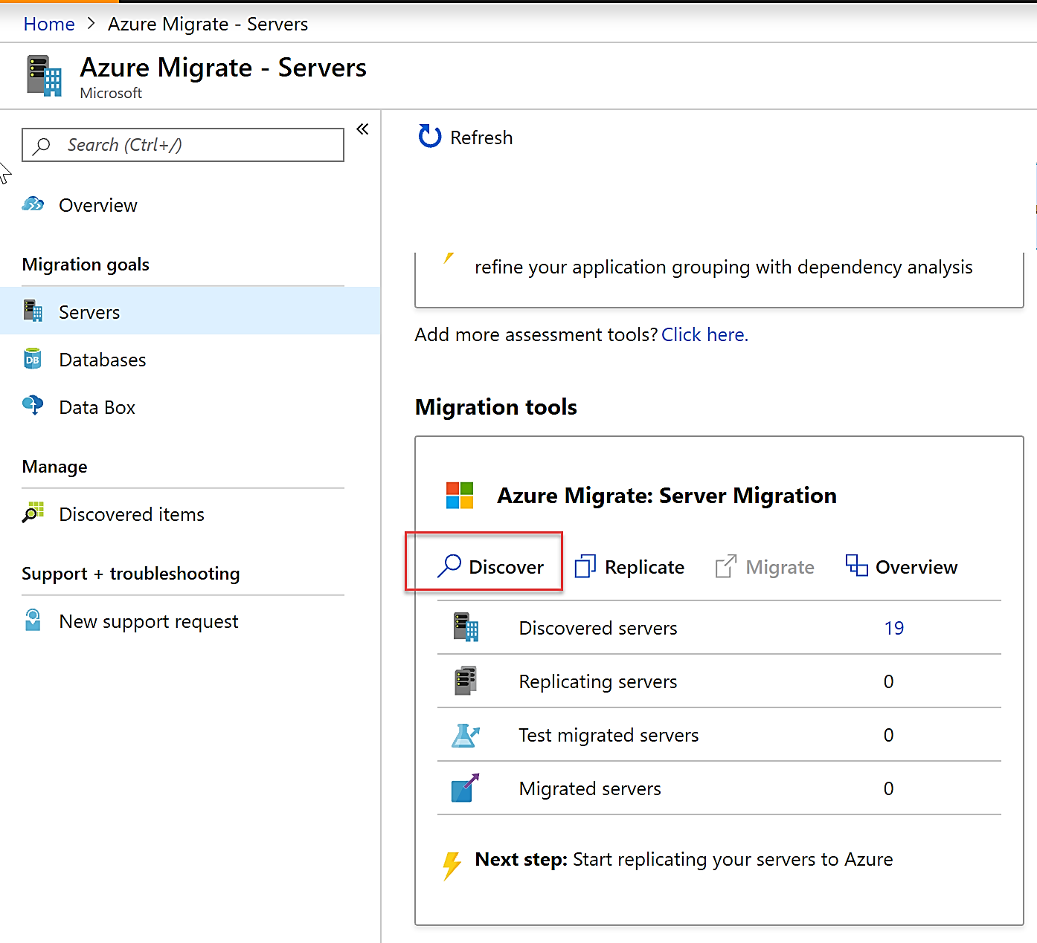
Download the appliance template as follows:
In the Azure Migrate project click Servers under Migration Goals
In Azure Migrate - Servers > Azure Migrate: Server Migration, click Discover.

Slide 39
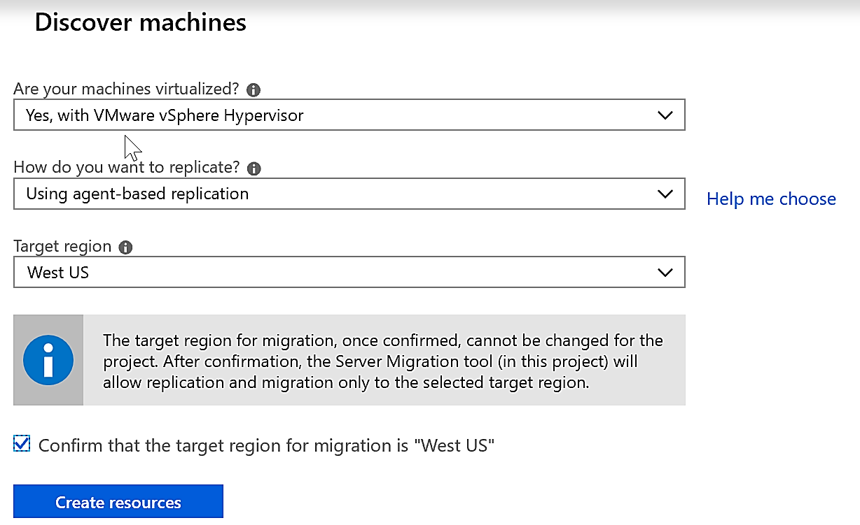
Discover Machines

Slide 40
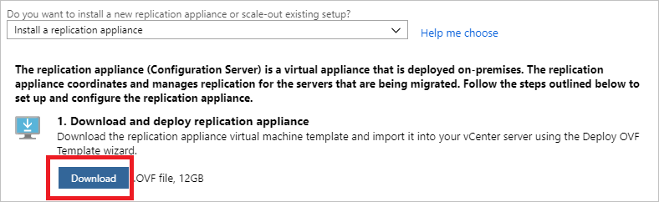
Download Appliance
In Do you want to install a new replication appliance?, select Install a replication appliance.
Click Download, to download the replication appliance. This downloads an OVF template that you use to create a new VMware VM that runs the appliance.
Note the name of the resource group and the Recovery Services vault. You need these during appliance deployment.

Slide 41
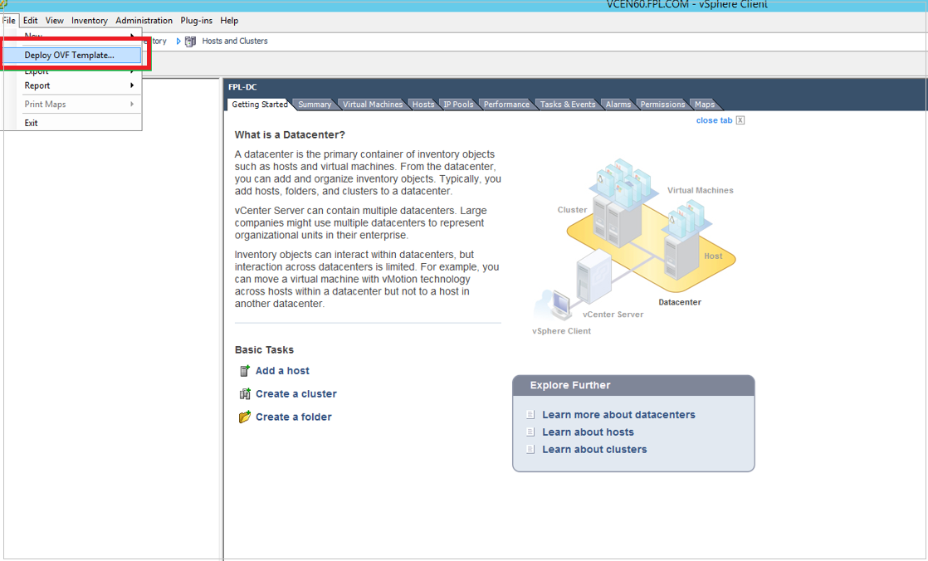
Import Appliance to VMware
After downloading the OVF template, import it into VMware to create the replication application on a VMware VM running Windows Server 2016

Slide 42
Appliance Setup and Registration
Replication appliance setup
From the VMWare vSphere Client console, turn on the VM
VM boots up into Windows Server 2016 installation experience
After installation completes sign in as administrator
After appliance connects to Azure, Configuration Server Management Wizard starts automatically
Register the replication appliance
Set up connectivity
Supply subscription, resource groups, and vault details
Install third-party software and the VMware PowerCLI
Configure vCenter Server/vSphere ESXi server
Configure virtual machine credentials

Slide 43
Replicate VMs
In the Azure Migrate project > Servers, Azure Migrate: Server Migration, click Replicate

Slide 44
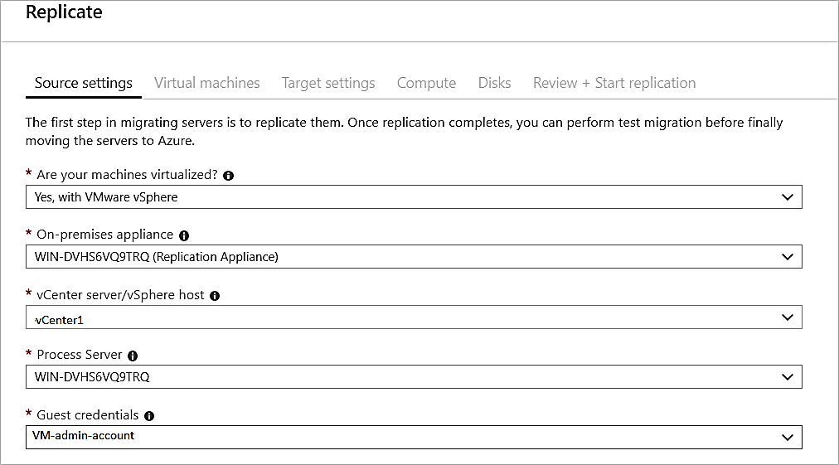
In Replicate, > Source settings > Are your machines virtualized?, select Yes, with VMware vSphere

Slide 45
In Virtual machines, select the machines you want to replicate.

Slide 46
In Virtual machines, search for VMs as needed, and check each VM you want to migrate. Then click Next: Target settings.

Slide 47
Target Settings

Slide 48
Compute Settings

Slide 49
Disk Settings

Slide 50
Tracking and Monitoring Replication
You can monitor replication status by clicking on Replicating servers in Azure Migrate: Server Migration

Slide 51
Test Migration
In Migration goals > Servers > Azure Migrate: Server Migration, click Test migrated servers.

Slide 52
Right-click the VM to test, and click Test migrate

Slide 53
After the test is done, right-click the Azure VM in Replicating machines, and click Clean up test migration

Slide 54
Lesson 4: Azure Backup Overview

Slide 55
Azure Backup Overview
Azure VM Backup Architecture
Microsoft Azure Backup Overview
Azure Backup Key Features
Azure IaaS Backup Components
Recovery Services Vault Overview

Slide 56
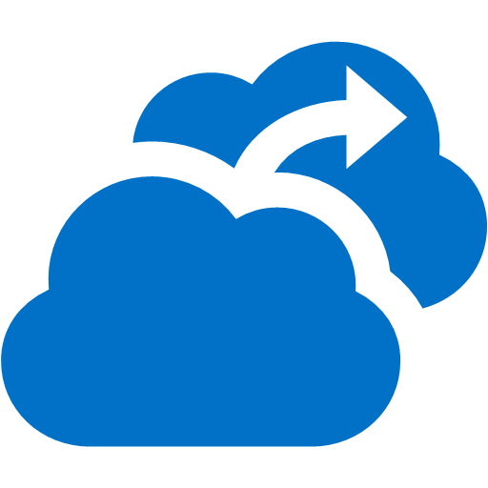

Azure VM Backup Architecture
1
Configure
Azure Backup Service
2
Backup
Policy Management
Azure Key Vault
KEK
Up to 4 TB per Disk
Recovery Services Vault
3
BEK
Up to 1,000 Azure VMs
VSS Snapshot
Instant Recovery Snapshot
Incremental
Blocks
4
HTTPS
SSE
Managed Disks

Slide 57
Microsoft Azure Backup Overview
Simple and reliable server backup to the cloud
Reliable offsite data protection
A simple and integrated solution
Efficient backup and recovery
Convenient offsite protection
Safe data
Encrypted backups
Familiar interface
Azure integration
Efficient use of bandwidth and storage
Flexible configuration
Flexibility in recovery
Cost-effective and metered by usage

Slide 58
Azure Backup Key Features
Simple configuration and management
Simple, and familiar user interface to configure and monitor backups from Windows Server and System Center Data Protection Manager
Integrated recovery experience to transparently recover files and folders from the cloud
Windows PowerShell command-line interface scripting capability
Block level incremental backups
Automatic incremental backups track file and block level changes, only transferring the changed blocks, hence reducing the storage and bandwidth utilization
Different point-in-time versions of the backups use storage efficiently by only storing the changed blocks between these versions

Slide 59
Azure Backup Key Features (continued)
Data integrity verified in the cloud
Backed up data is also automatically checked for integrity once the backup is complete. As a result, any corruptions due to data transfer are automatically identified and repair is attempted in the next backup
Configurable retention policies
Retention policies are used to control how long a backup will be saved in Azure. This helps to meet business policies and manage backup costs

Slide 60
Azure IaaS Backup Components
Component | Benefits | Limits | What is protected? | Where are backups stored?
Azure Backup Server (can be deployed in Azure and on-premises) | • App aware snapshots (VSS) • Full flexibility for when to take backups • Recovery granularity (all) • Can use Recovery Services vault • Linux support on Hyper-V and VMware VMs • Back up and restore VMware VMs • Does not require a System Center license | • Cannot back up Oracle workload. • Always requires live Azure subscription • No support for tape backup | • Files, • Folders, • Volumes, • VMs, • Applications, Workloads, System State | • Recovery Services vault, • Locally attached disk
Azure IaaS VM Backup | • Native backups for Windows/Linux • No specific agent installation required • Fabric-level backup with no backup infrastructure needed | • Back up VMs once-a-day • Restore VMs only at disk level • Cannot back up on-premises | • VMs, • All disks (using PowerShell) | Recovery Services vault

Slide 61
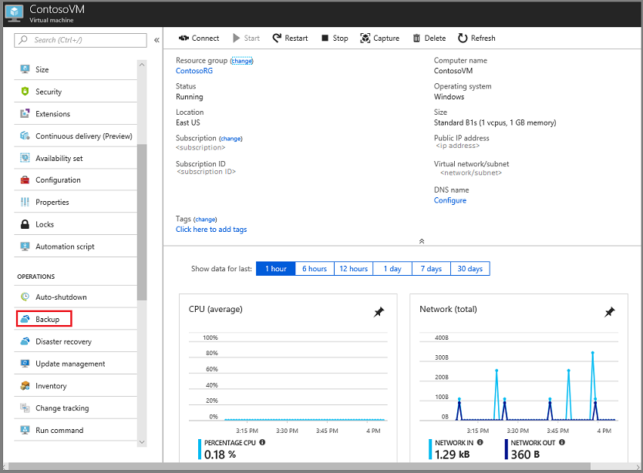
Recovery Services Vault Overview
Secures Backup Data
Monitoring
Role Based Access Control

Slide 62
Lesson 05: Azure to Azure Site Recovery

Slide 63
Azure to Azure Site Recovery
Replicate Azure VMs to any other Azure location
No infrastructure to deploy
Automatically deploys ASR Mobility Service extension to protected machines
Replicates
VMs
Virtual Networks
Availability Sets
Storage accounts
Optionally – you can specify your own VNets, Storage Accounts and Availability Sets
Replicates on HTTPS channel on 443
Generates Azure egress cost for outbound traffic from primary region

Slide 64
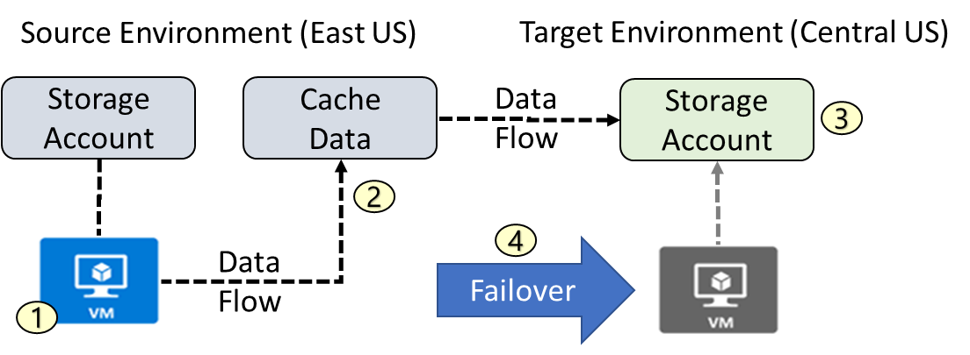
Azure to Azure Architecture
VM is registered with Azure Site Recovery
Data is continuously replicated to cache
Cache is replicated to the target storage account
During failover the virtual machine is added to the target environment

Slide 65
Azure to Azure Site Recovery: Network Traffic
ASR traffic is only outbound from protected VMs.
Access to ASR URLs
*.blob.core.windows.net for storage account writes
login.microsoftonline.com authorization and authentication to the ASR URLs
*.hypervrecoverymanager.windowsazure.com ASR service communication channel
*.servicebus.windows.net monitoring and diagnostics
Outbound security rules for NSGs
Site Recovery service and monitoring IP addresses (location specific)
https://docs.microsoft.com/en-us/azure/site-recovery/site-recovery-azure-to-azure-networking-guidance#sample-nsg-configuration
Location | Site Recovery service IPs | Site Recovery monitoring IP
Central US | 40.69.144.231 | 52.165.34.144

Slide 66
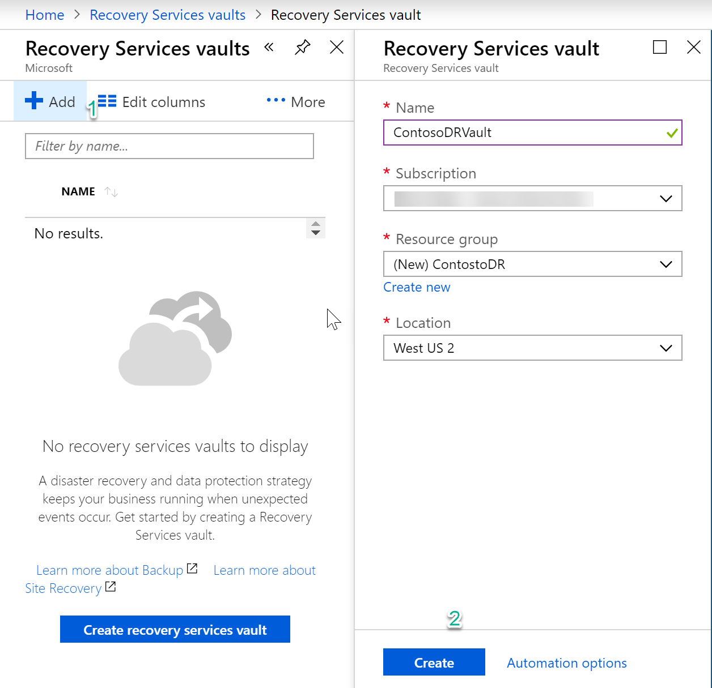
Azure to Azure VM Protection
Establish a recovery services vault
In a different location than where your VMs reside

Slide 67
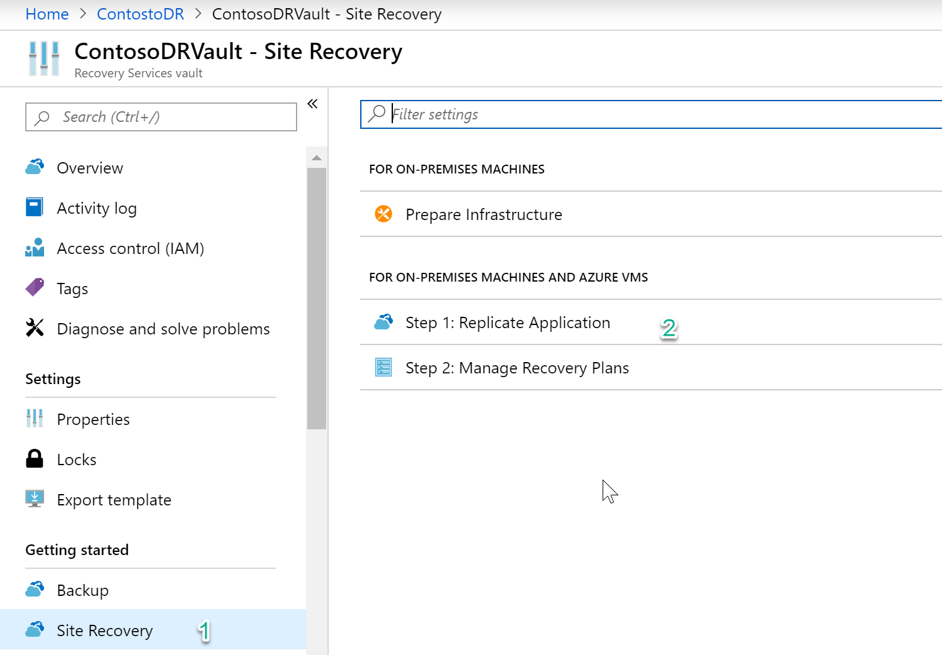
Configuration
Getting Started – Site Recovery
No infrastructure to prepare
Step 1: Replicate Application

Slide 68
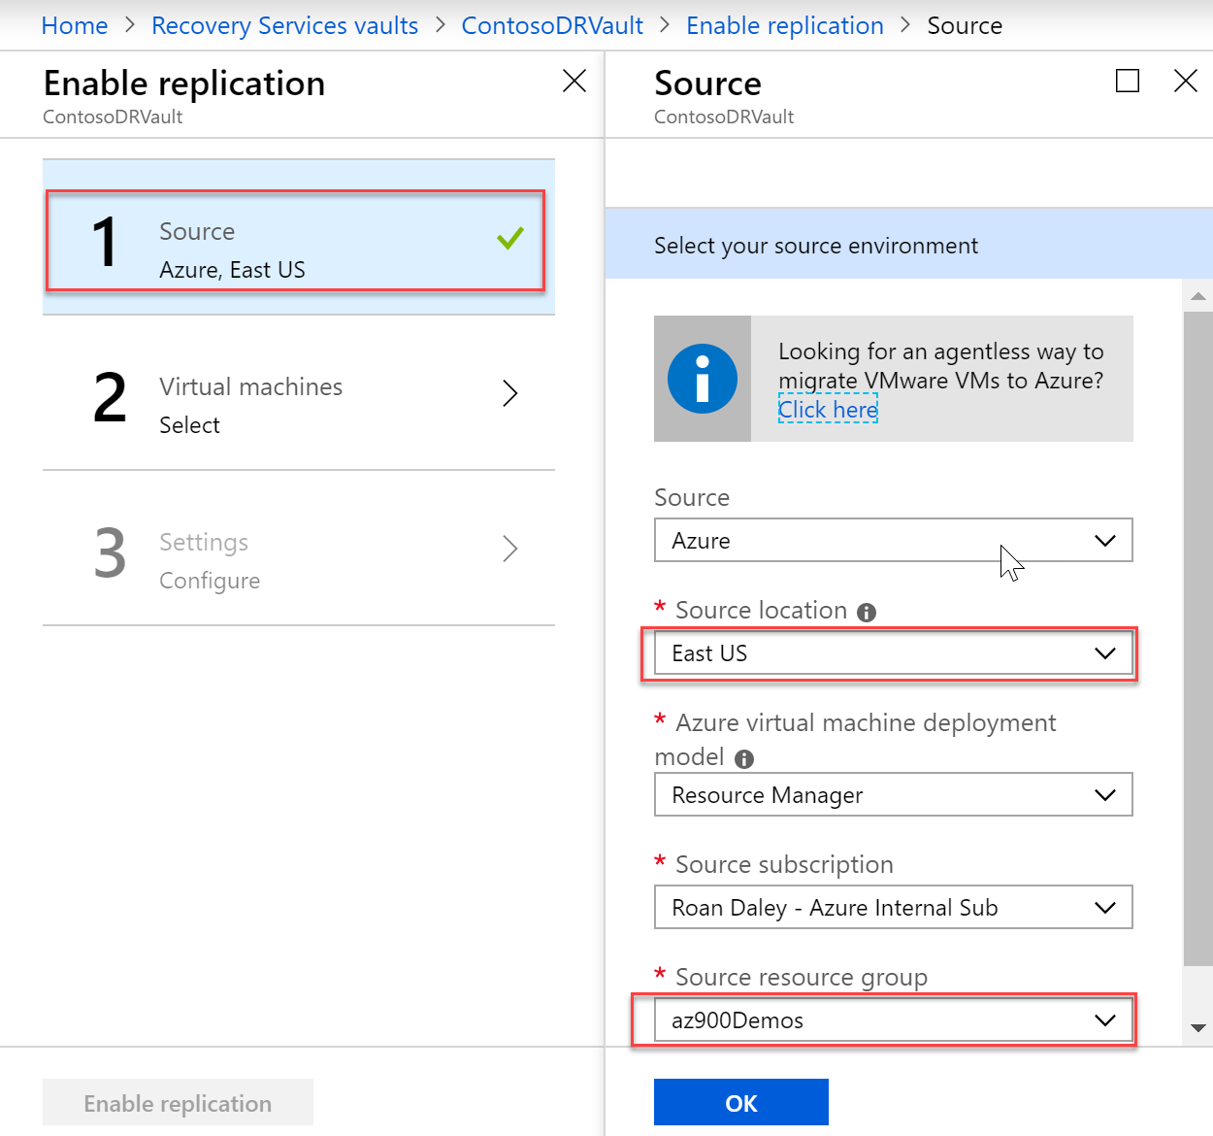
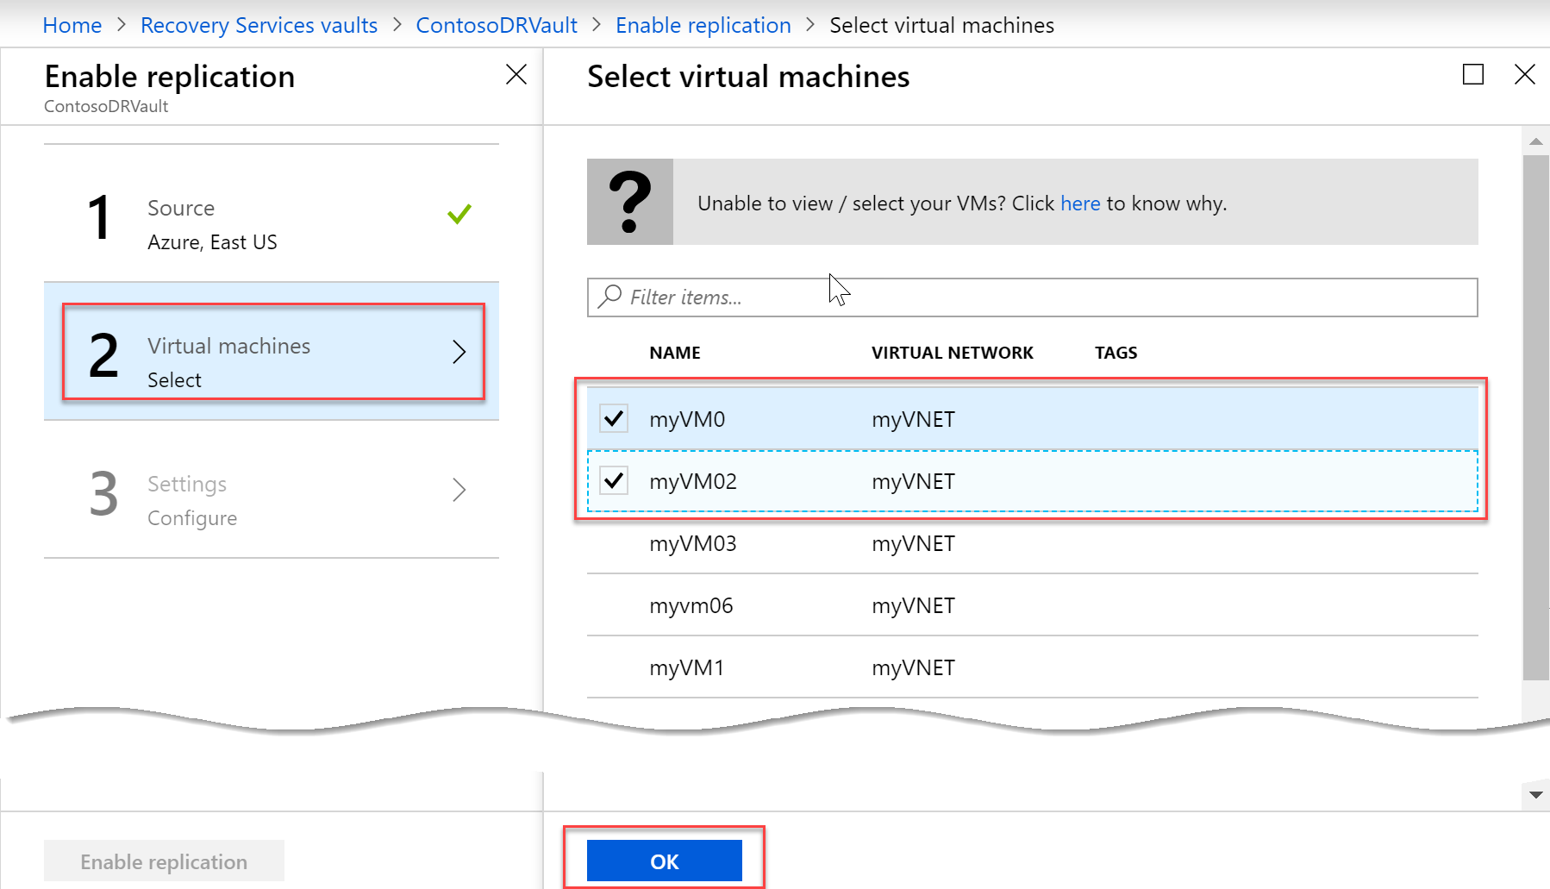
Enable Replication

Slide 69
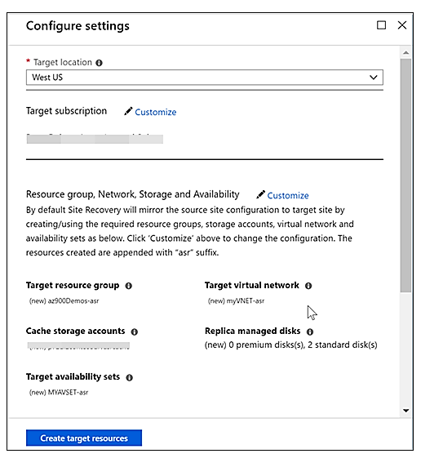
Settings
Target location
Same as vault
System (can) replicates
VM
Resource Group Name
Virtual Network
Availability Sets

Slide 70
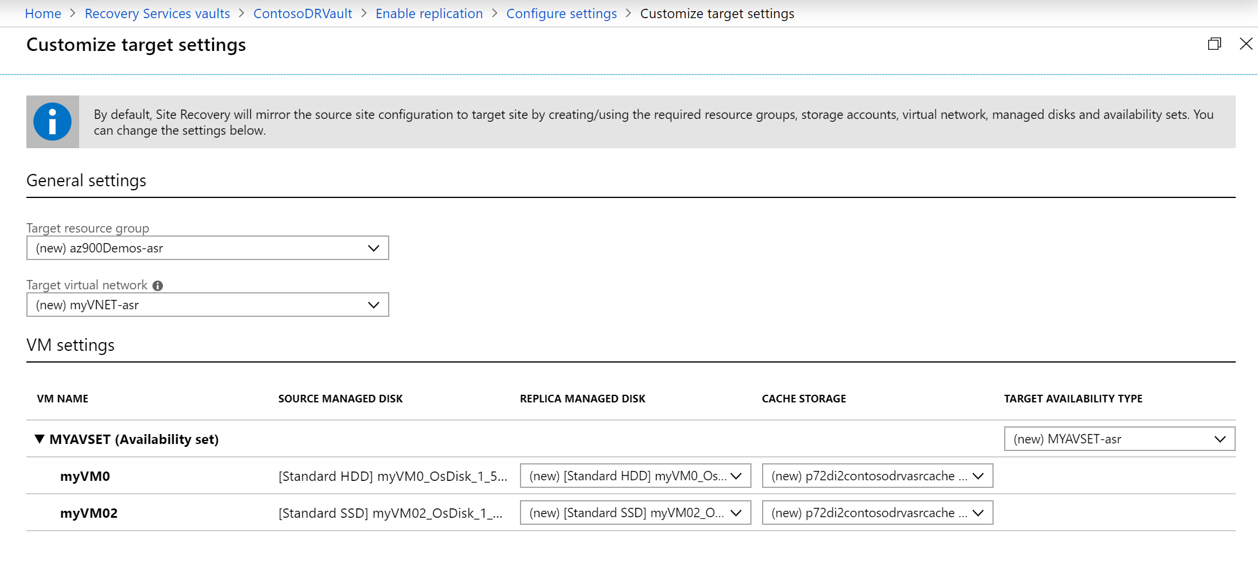
Customize target resources

Slide 71
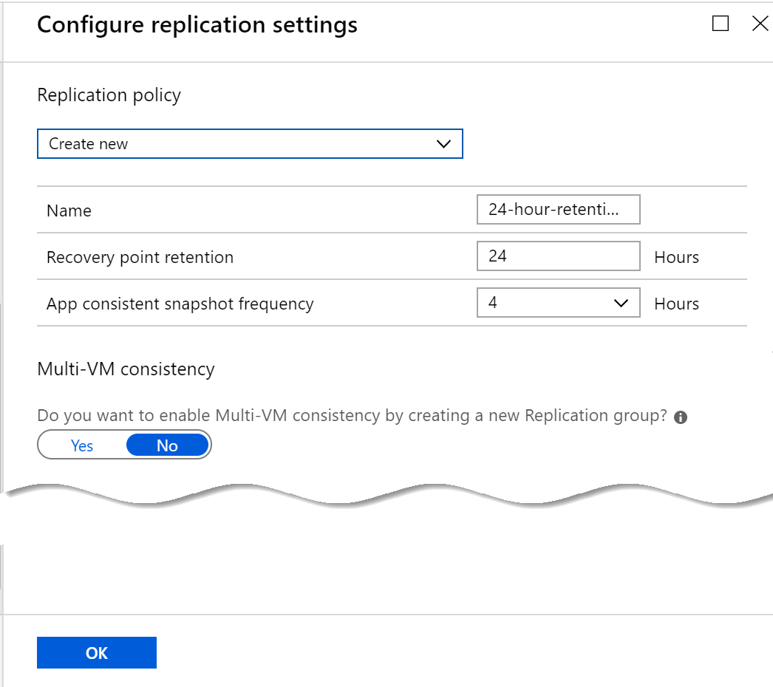
Replication Settings
Configure
Recovery Point Retention
App Consistency
Multi VM Consistency

Slide 72
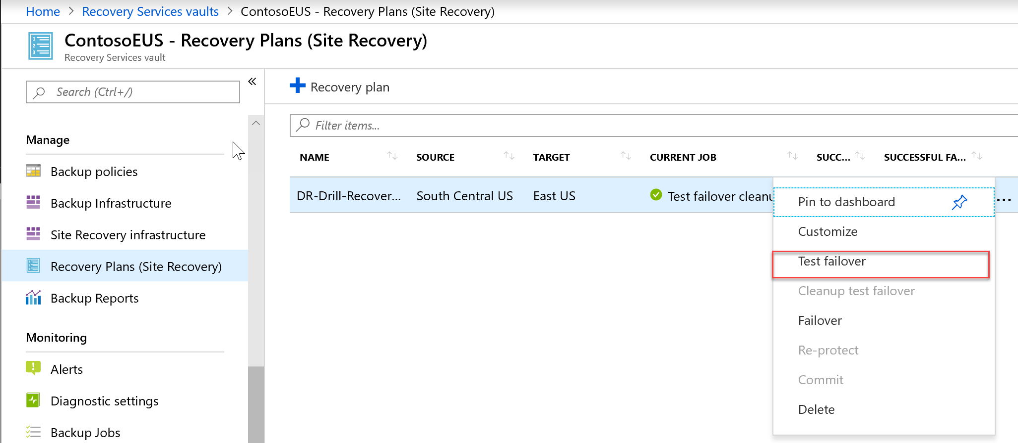
Test Failover

Slide 73
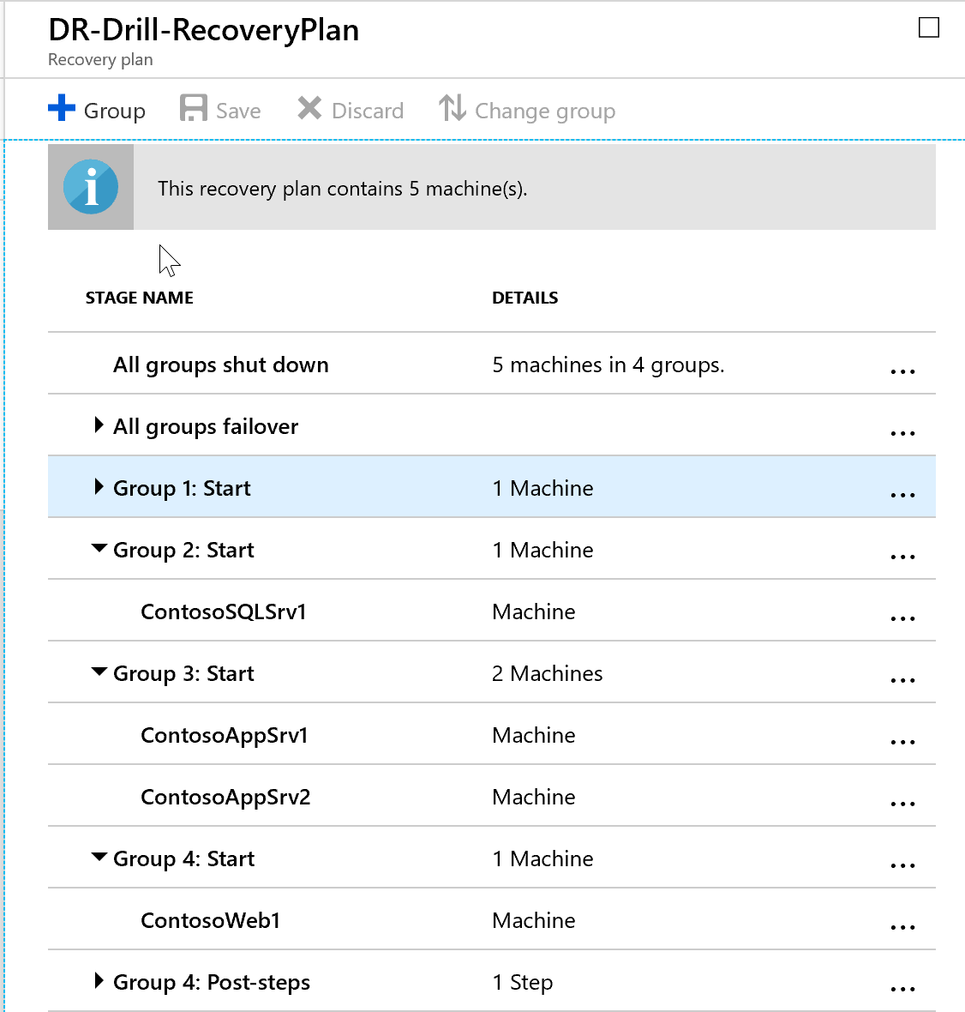
Recovery Plans
Use recovery plans to:
Model an app around its dependencies.
Automate recovery tasks to reduce RTO.
Verify that you're prepared for migration or disaster recovery by ensuring that your apps are part of a recovery plan.
Run test failover on recovery plans, to ensure disaster recovery or migration is working as expected.

Slide 74
Lab: Protecting Hyper-V VMs by using Azure Site Recovery
Configure Azure Site Recovery
Perform test failover
Perform planned failover
Perform unplanned failover

